Slide 1


National Science & Technology Exhibition Week Pre-Conference Data Science Workshop
nairobi
Shelmith N. Kariuki

Slide 2





Statistical Languages

Slide 3
Statistical Languages (Data Science)

Slide 4
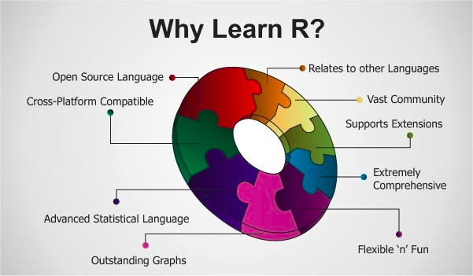
Why use R?

Slide 5
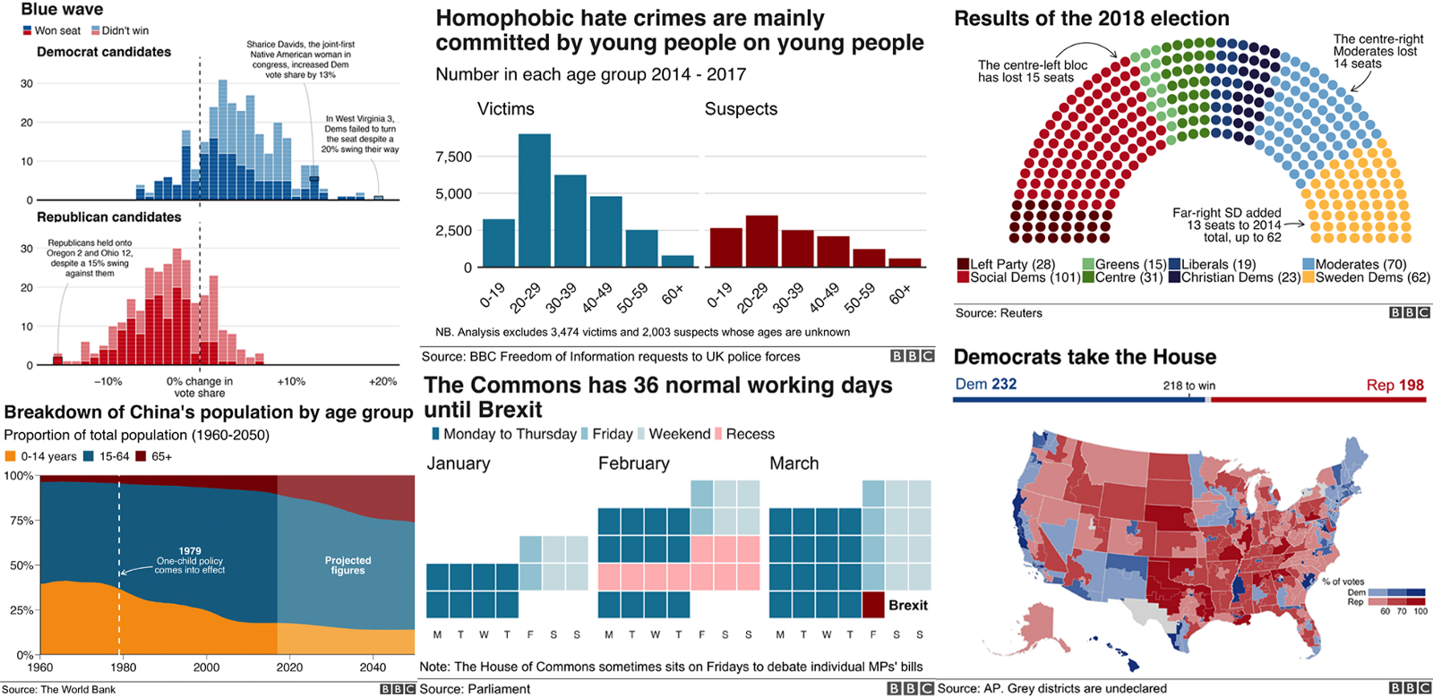
Use Cases

Slide 6
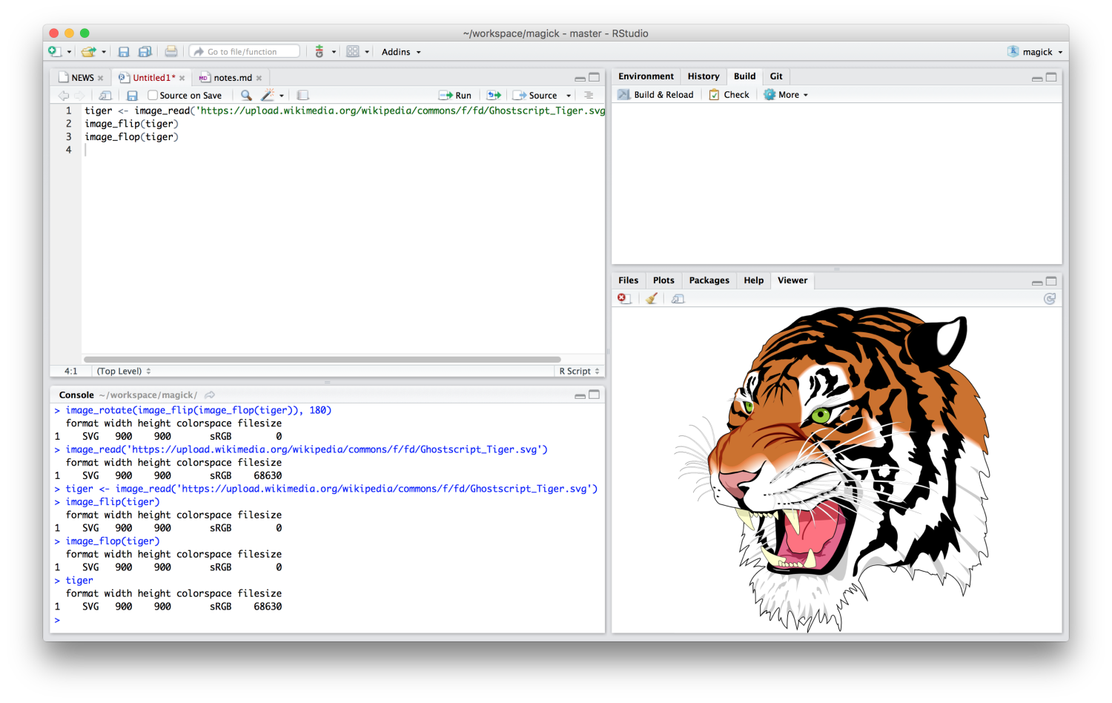
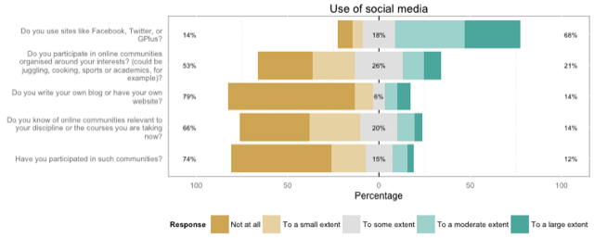
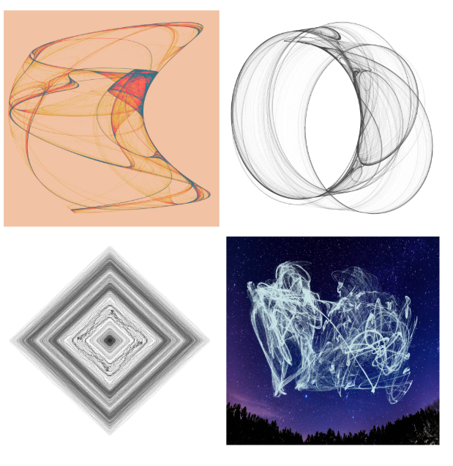
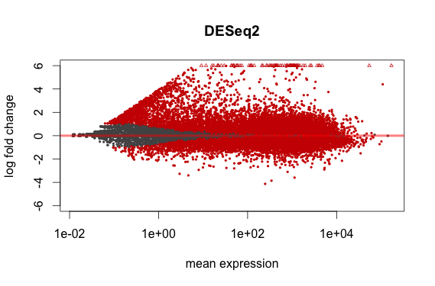
Use Cases: Cont'd

Slide 7
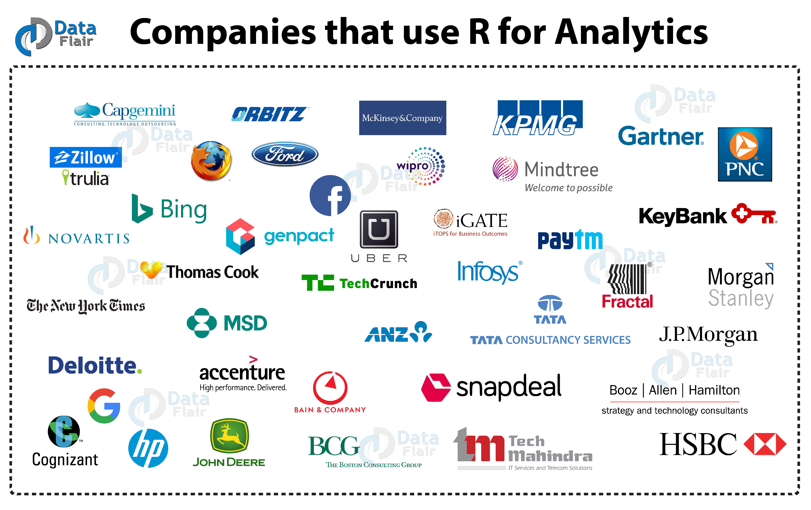

Slide 8

AfricaR
Mission:
To achieve improved representation and empower the African population of all genders, who are underrepresented in the global R community.
Support already existing R User Groups (RUGs) across Africa, and R enthusiasts to embrace the full potential of R programming.
Through fostering a collaborative continental network of R gurus, mentors, learners, developers and leaders, to help facilitate individual and collective progress worldwide.

Slide 9

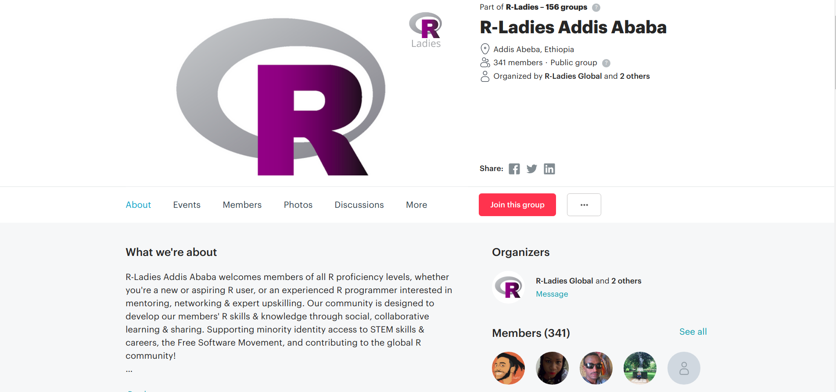
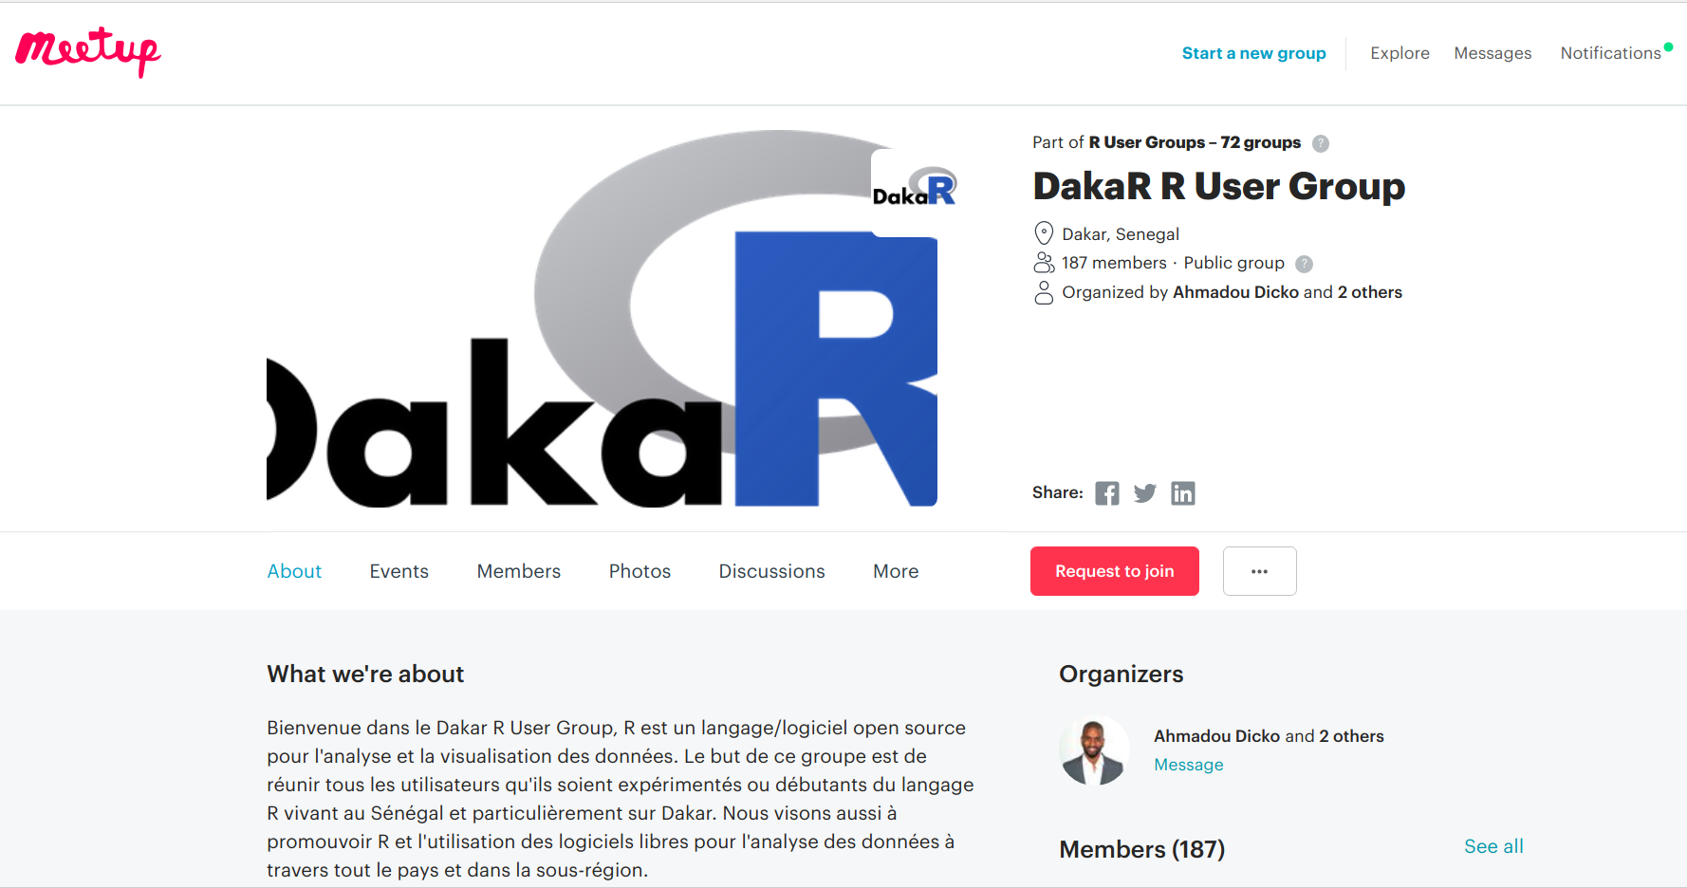
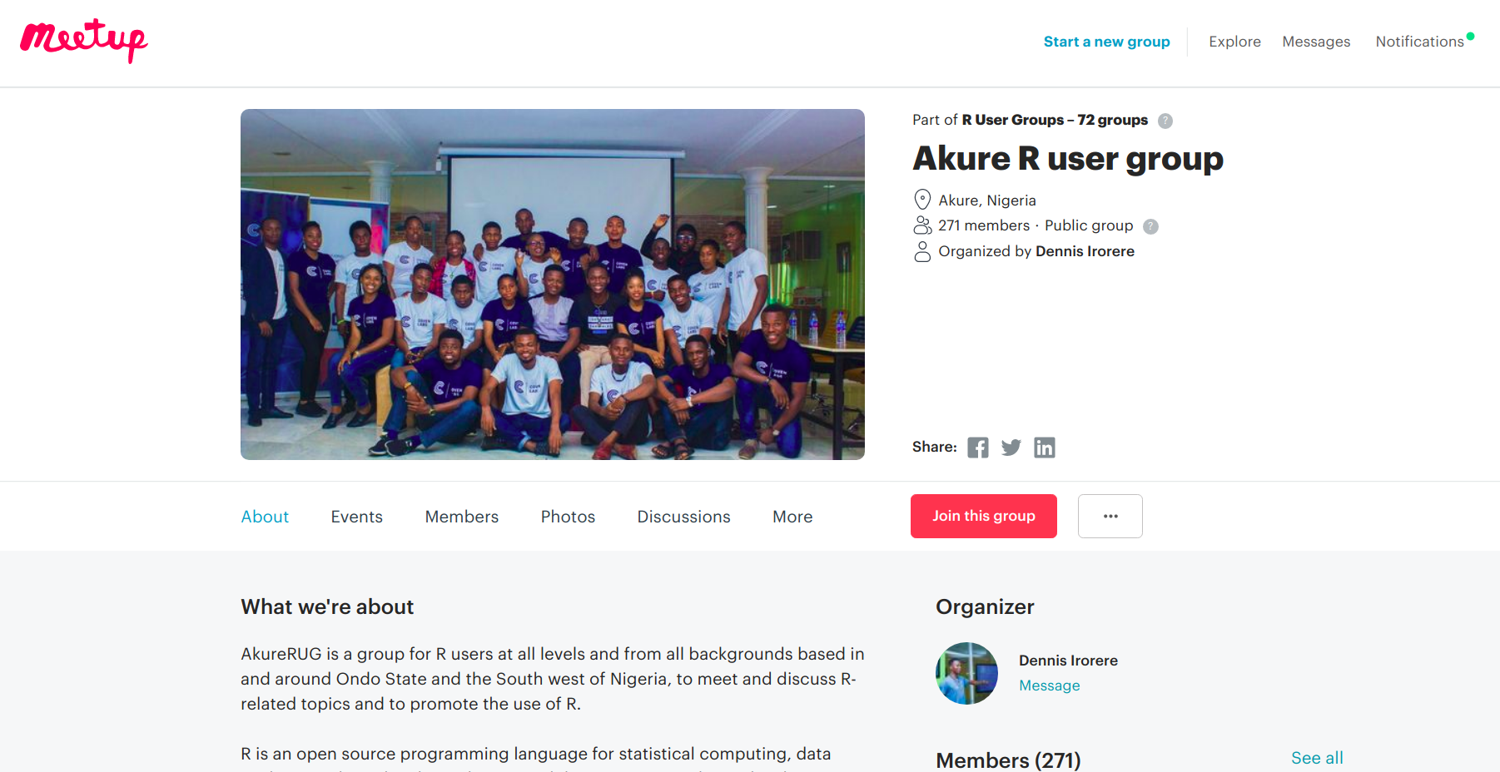
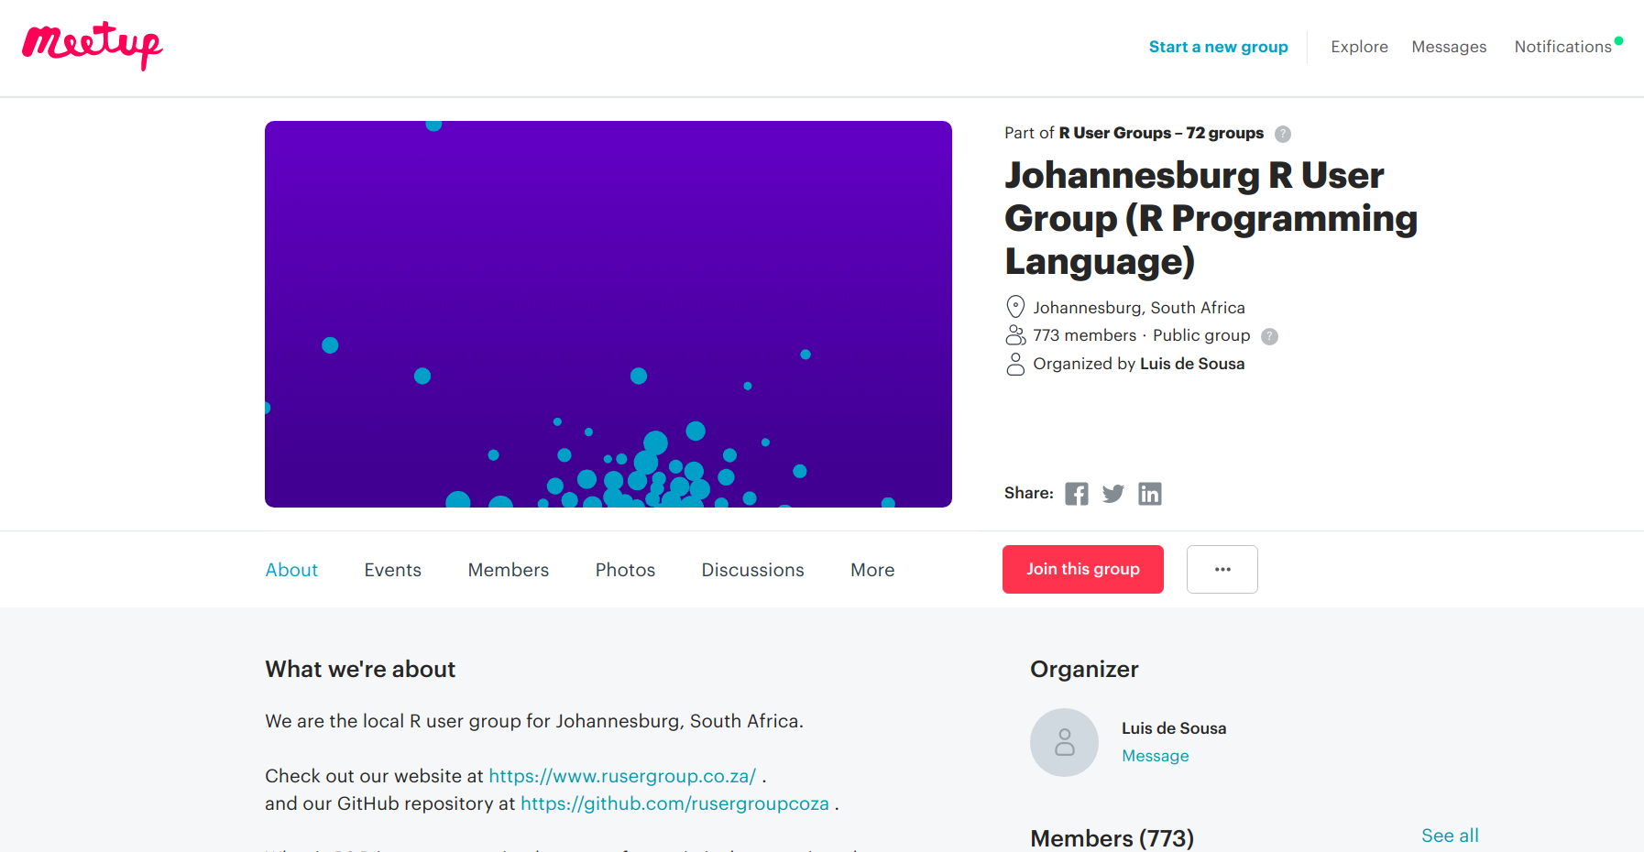

African RUGs

Slide 10

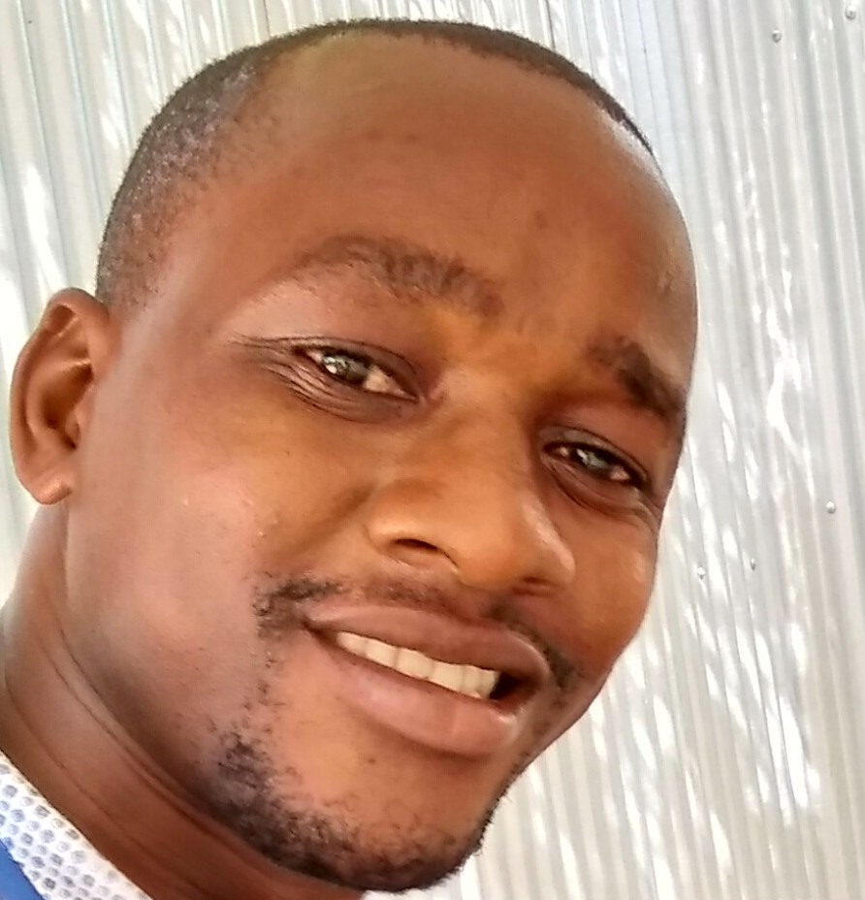
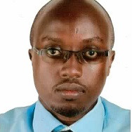
nairobi
Kigen Tembu
Data Scientist
MUSONI
Shelmith Kariuki
Senior Data Analyst
AfricaR
Christopher Maronga
Data Manager
KEMRI WELLCOME TRUST

Slide 11
nairobi : Objectives
Leverage open source R to impart practical data analytics skills.
Bring the current R users together.
Work with Kenyan universities, to re design the statistical R curriculum.
Introduce / enhance R in companies that work with data

Slide 12
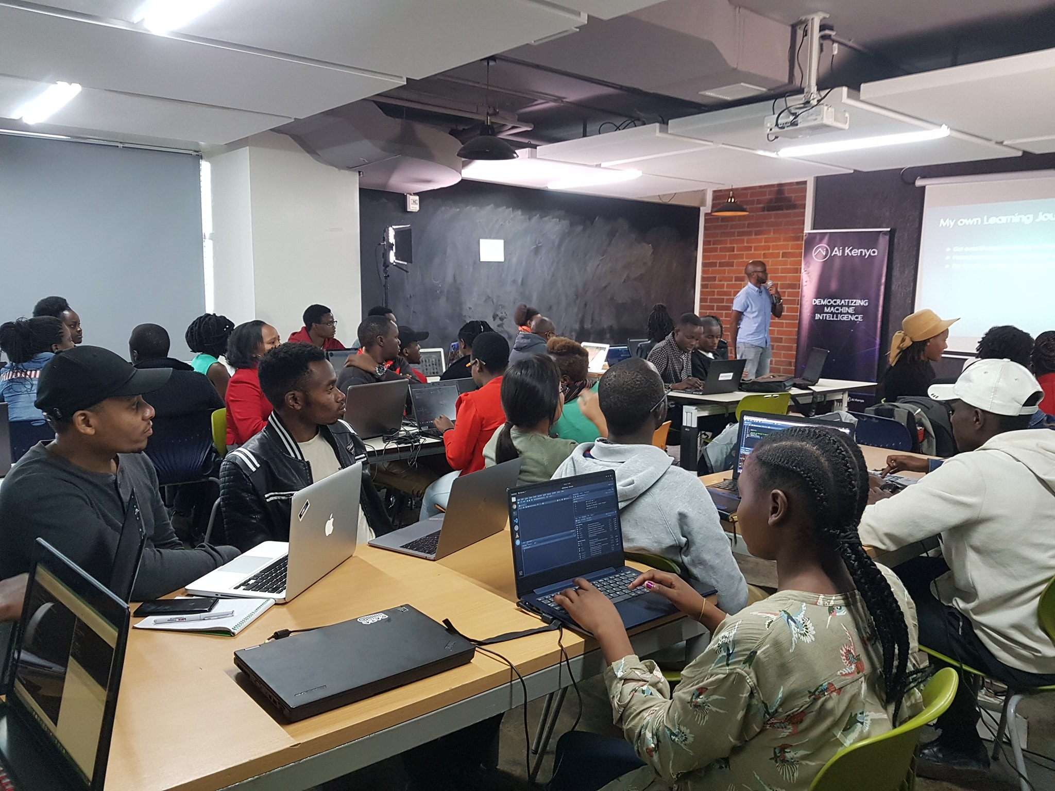
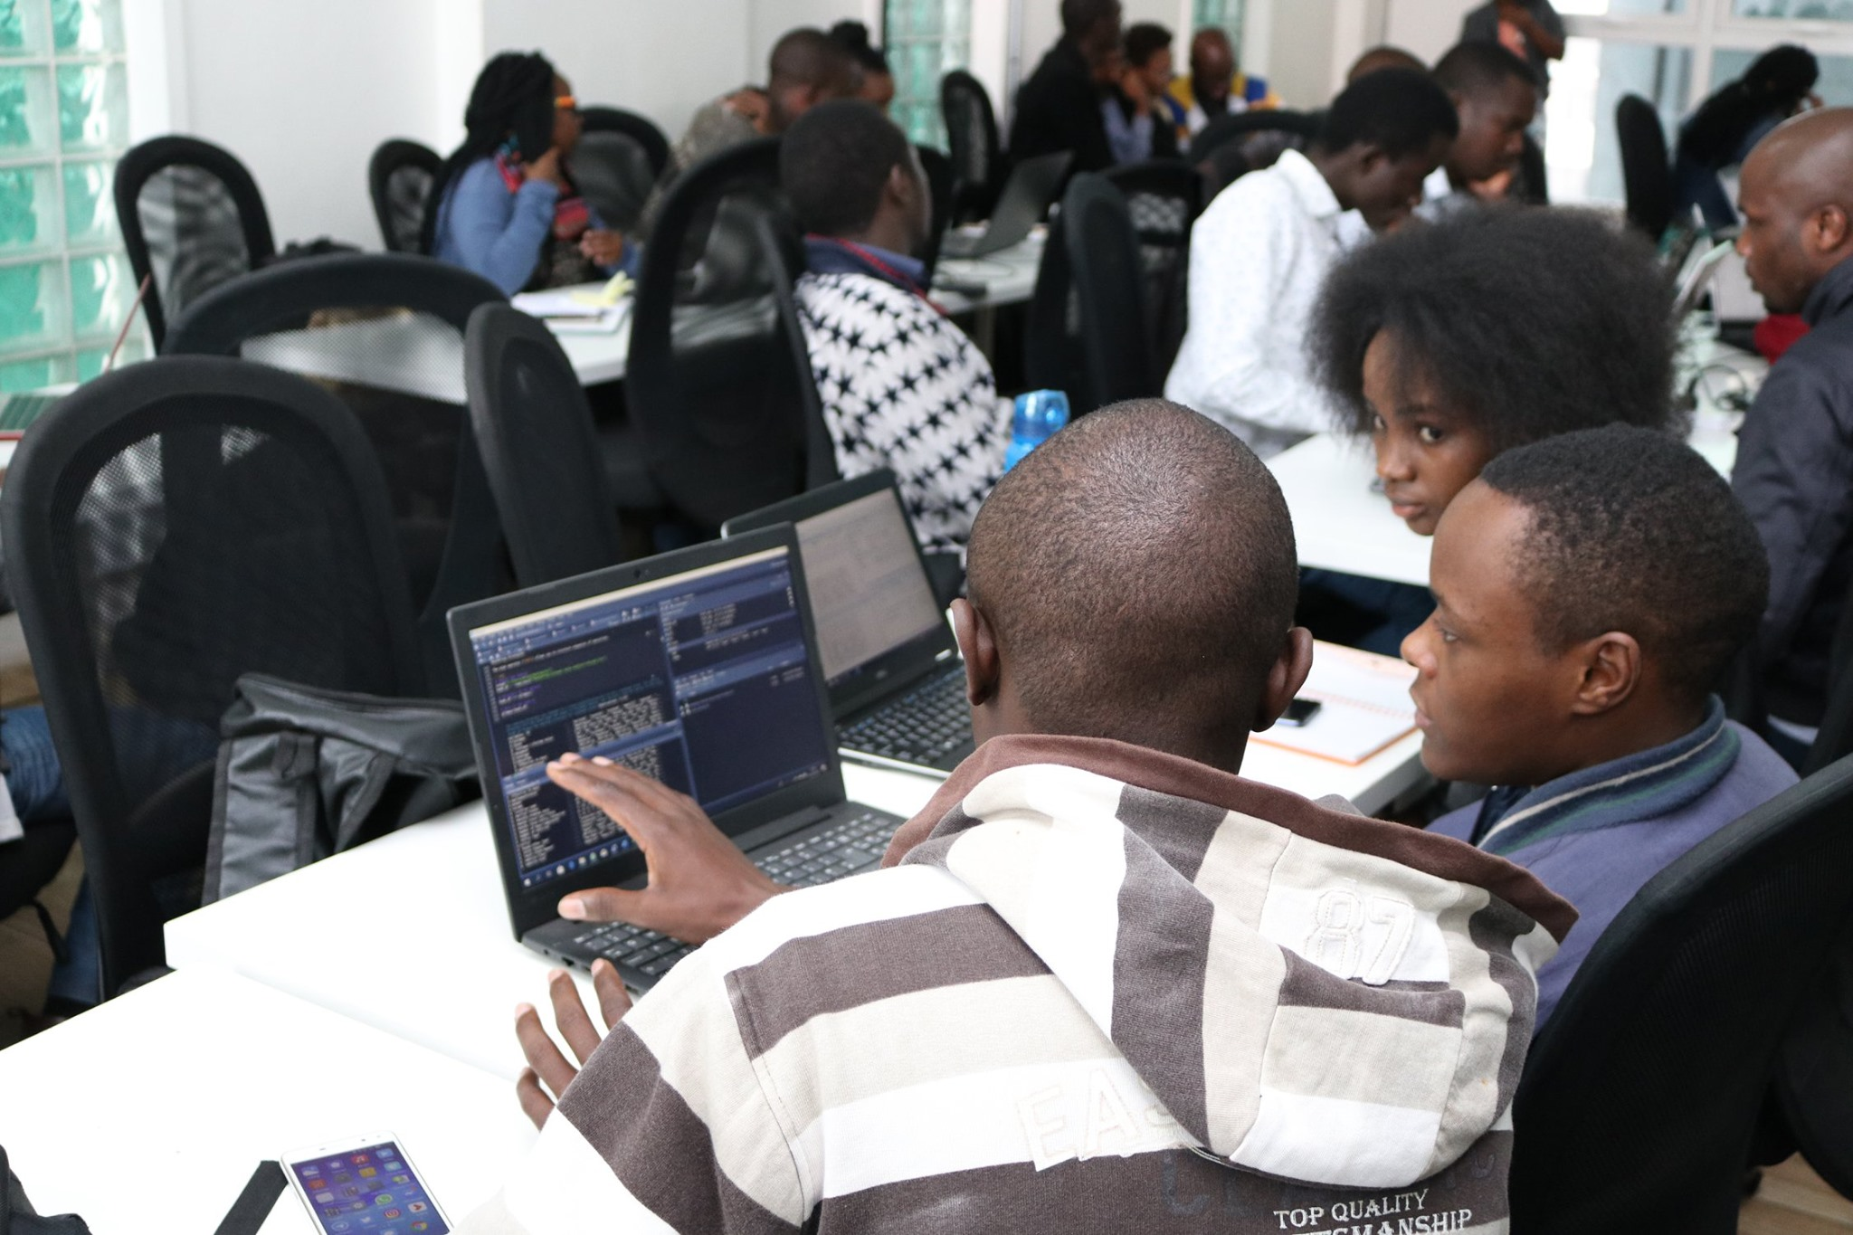
nairobi :
1st MeetUp @iHub
2nd MeetUp @ALX, Nairobi Garage

Slide 13
nairobi : How can you be involved?
Attend our meetups (you will leaRn!!!)
Offer venues for our monthly meetups
Academics need to consult those in the field, on matters curriculum.
Statistical courses taught by field experts
Sponsorship for SatRday Nairobi event
Sponsorship for ARUM 2020 / ARUM 2021 event (similar to Pycon Africa / DSA)

Slide 14
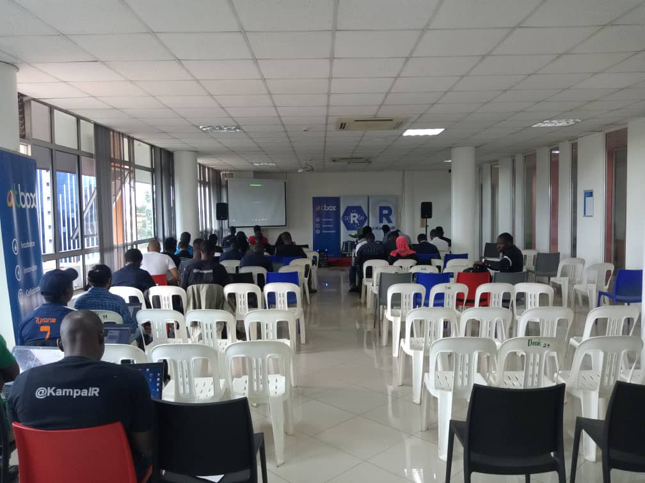
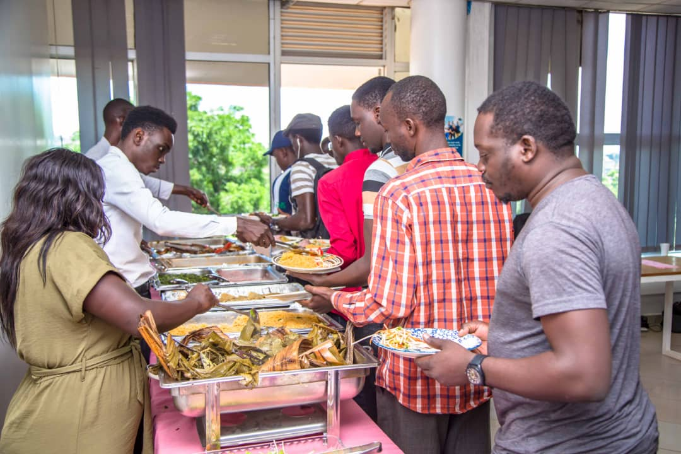
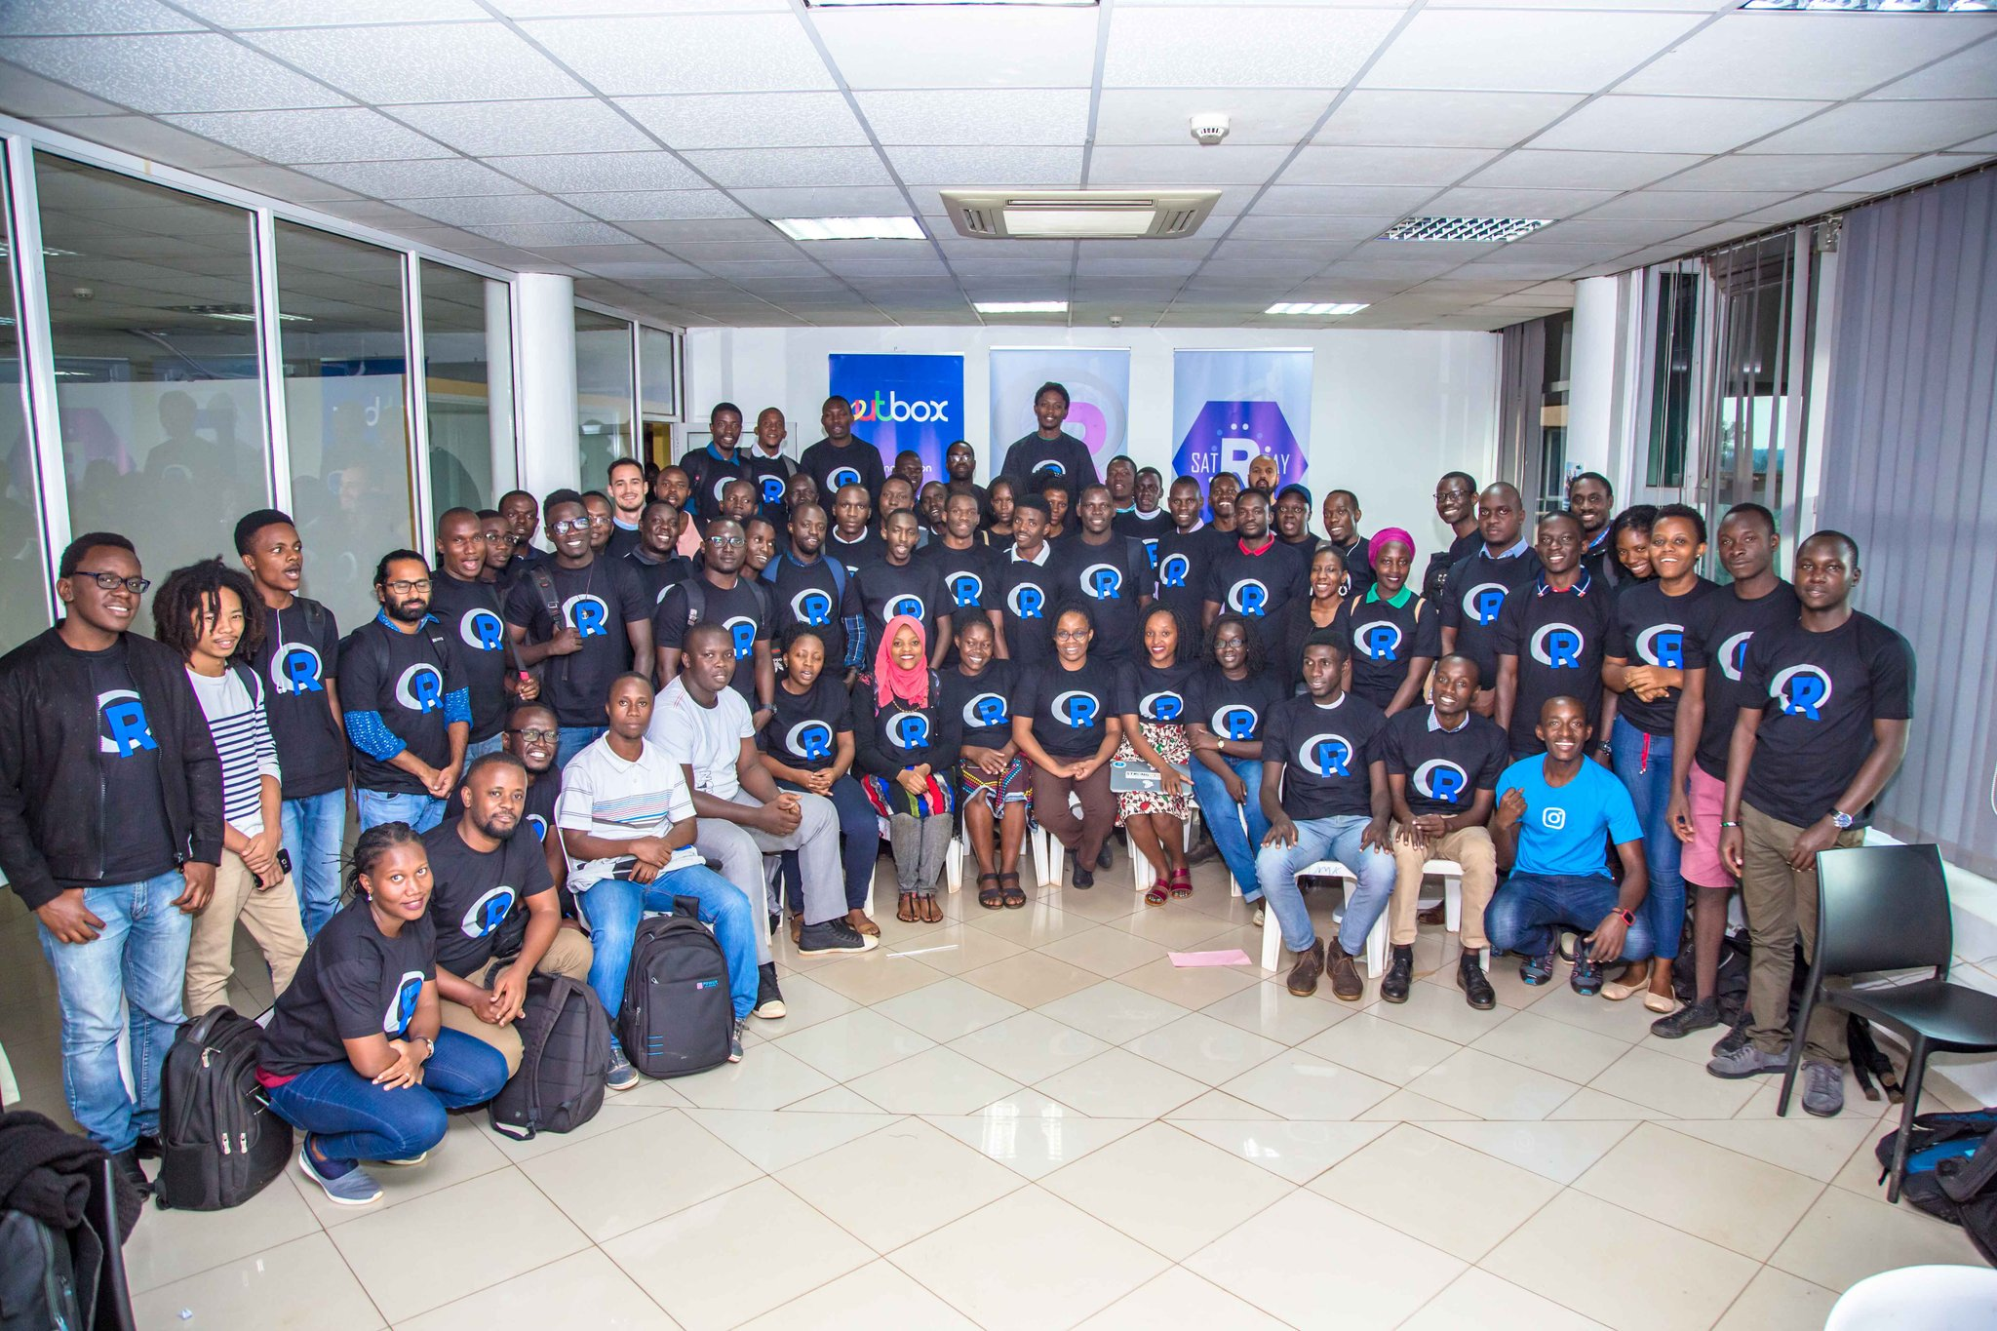
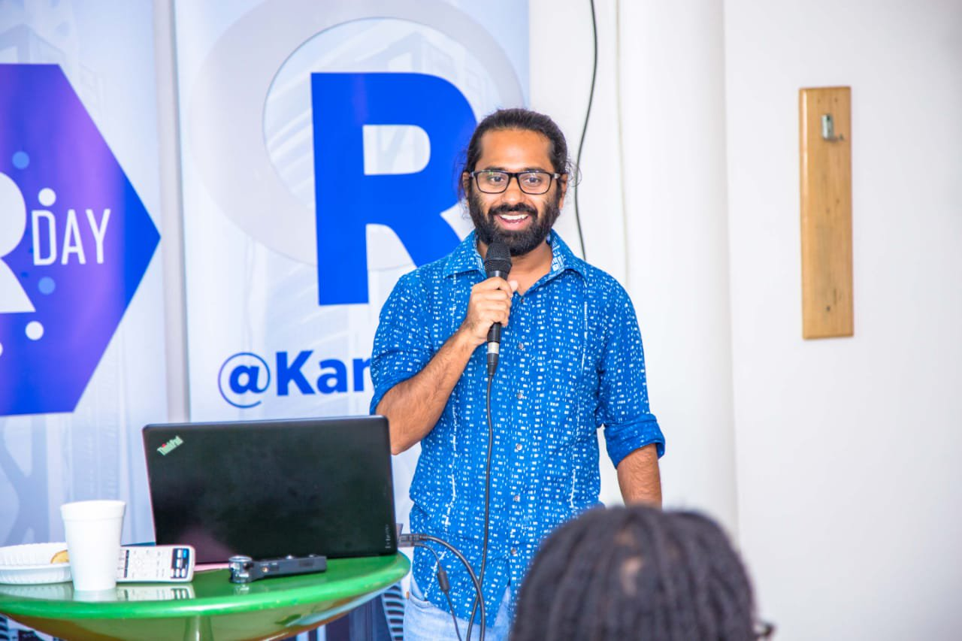
SatRdays

Slide 15









Grand AfricaR Conference (ARUM 2020)

Slide 16
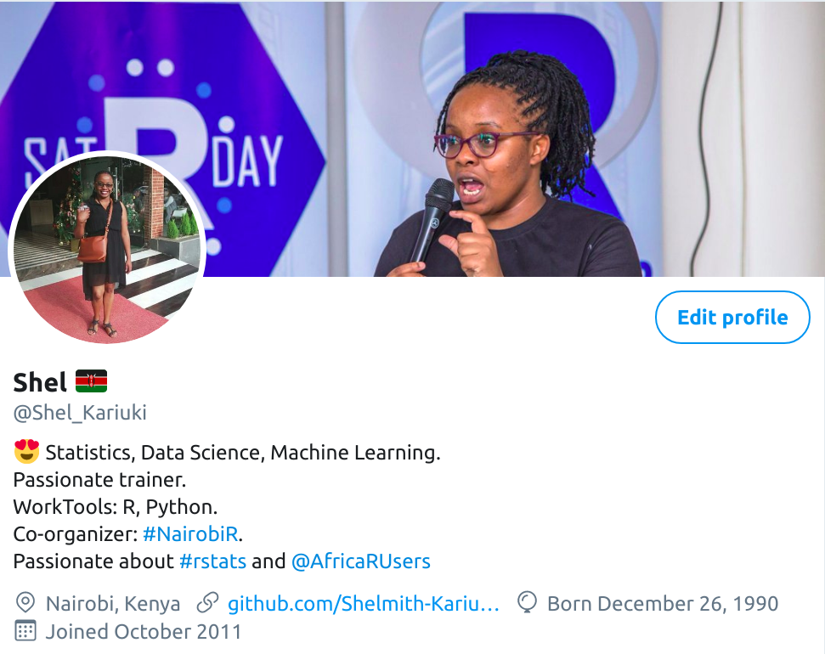
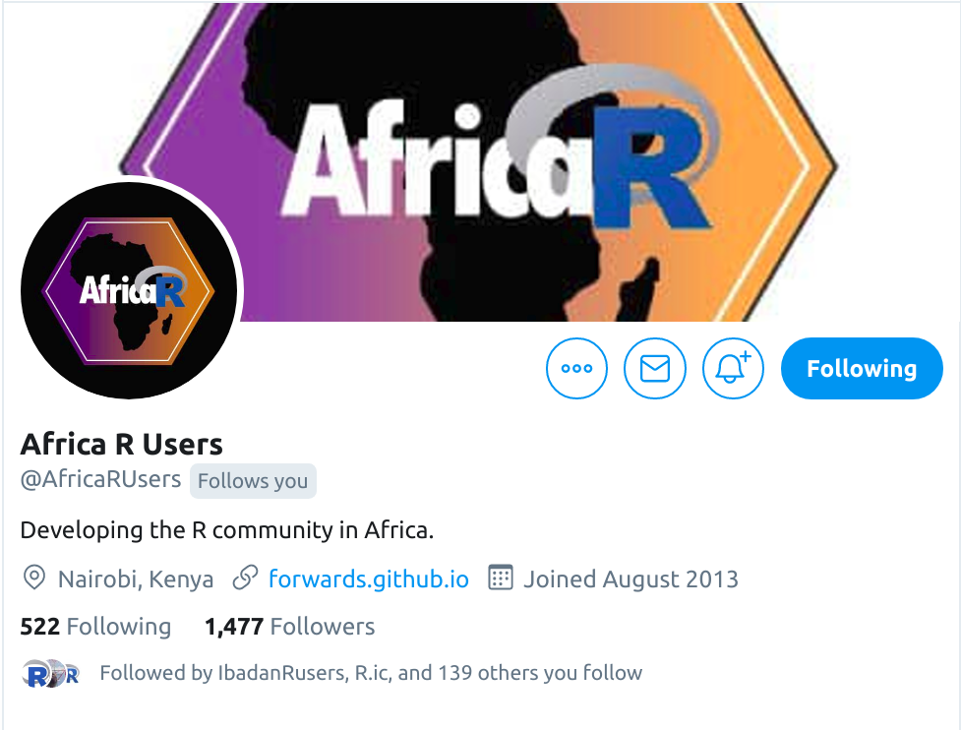
Follow us on twitter

Slide 17


